Slide 1
Diabetes Prediction with Machine Learning
Early Detection Using Medical and Demographic Data

Slide 2
Problem Statement
The objective of this project is to develop a machine learning model to predict whether a patient has diabetes (binary classification: 0 for no diabetes, 1 for diabetes) based on medical and demographic features. The dataset includes key indicators such as HbA1c level (a level above 6.5% typically indicates diabetes), blood glucose level, BMI, age, gender, hypertension, heart disease, and smoking history, which are known to influence diabetes risk. This problem is critical for:
Healthcare Applications: Enabling early identification of at-risk patients to facilitate timely interventions and tailored treatment plans.
Research Purposes: Investigating the relationships between medical/demographic factors and diabetes likelihood to inform preventive strategies. The challenge lies in handling class imbalance (only ~8.5% of patients have diabetes), ensuring model generalizability, and addressing data quality issues like duplicates (3,854 detected) to build a reliable and interpretable predictive system.

Slide 3
Data Information
The Diabetes Prediction Dataset is a collection of medical and demographic data from patients, designed to predict diabetes status (positive or negative). It contains 100,000 entries with 9 columns, comprising numerical and categorical features. The dataset is valuable for building machine learning models to identify at-risk patients and for researching the relationships between various factors and diabetes likelihood. Below is a detailed description of the features, combining source information and analysis from the Jupyter notebook:

Slide 4
Features
gender:
Type: Categorical (object), encoded numerically using LabelEncoder (e.g., 0: Female, 1: Male, 2: Other).
Description: Represents the biological sex of the individual, which influences diabetes susceptibility. Categories: Male, Female, Other.
age:
Type: Numerical (float64).
Description: Patient's age in years, ranging from 0.08 to 80 (mean: 41.89, std: 22.52). Diabetes is more prevalent in older adults.
hypertension:
Type: Binary (int64).
Description: Indicates persistently elevated blood pressure, a risk factor for diabetes. Values: 0 (No hypertension), 1 (Hypertension; prevalence: ~7.5%).
heart_disease:
Type: Binary (int64).
Description: Indicates the presence of heart disease, associated with increased diabetes risk. Values: 0 (No heart disease), 1 (Heart disease; prevalence: ~3.9%).

Slide 5
smoking_history:
Type: Categorical (object), encoded numerically (e.g., 0: No Info, 1: Current, 4: Never).
Description: Represents smoking status, which can exacerbate diabetes complications. Categories: Not Current, Former, No Info, Current, Never, Ever.
bmi:
Type: Numerical (float64).
Description: Body Mass Index, measuring body fat based on weight and height, ranging from 10.01 to 95.69 (mean: 27.32, std: 6.64). Categories: <18.5 (Underweight), 18.5–24.9 (Normal), 25–29.9 (Overweight), ≥30 (Obese). Higher BMI is linked to increased diabetes risk.
HbA1c_level:
Type: Numerical (float64).
Description: Hemoglobin A1c level, reflecting average blood sugar over 2–3 months, ranging from 3.5 to 9.0% (mean: 5.53, std: 1.07). Levels >6.5% typically indicate diabetes.
blood_glucose_level:
Type: Numerical (int64).
Description: Blood glucose level at a given time, ranging from 80 to 300 (mean: 138.06, std: 40.71). High levels are a key diabetes indicator.
diabetes:
Type: Binary target variable (int64).
Description: Indicates diabetes status. Values: 0 (No diabetes), 1 (Diabetes; prevalence: ~8.5%).

Slide 6
Data Characteristics
Data Types:
Categorical: gender, smoking_history (converted to numerical via label encoding).
Numerical: age, BMI, HbA1c_level, blood_glucose_level.
Binary: hypertension, heart_disease, diabetes.
Missing Values: No missing values (isnull().sum() returns 0 for all columns).
Duplicates: 3,854 duplicated rows, which may inflate model performance if not addressed.
Shape: (100,000 rows, 9 columns).
Class Imbalance: The target variable, diabetes, has a mean of 0.085, indicating only 8.5% of patients have diabetes, necessitating techniques like SMOTE for balanced modeling.
Statistical Summary (from data.describe()):
Age: Mean 41.89, median 43, indicating a slightly right-skewed distribution.
BMI: Mean 27.32, median 27.32, with a wide range suggesting diverse body compositions.
HbA1c_level: Mean 5.53, with 75% of values ≤6.2, aligning with non-diabetic ranges.
Blood_glucose_level: Mean 138.06, with a broad range indicating variability in glucose control.
Hypertension and Heart Disease: Low prevalence (7.5% and 3.9%, respectively), suggesting sparse positive cases.

Slide 7
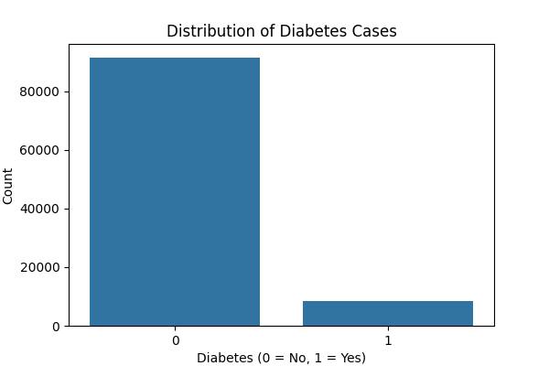
Exploratory Data Analysis (EDA)
The EDA section examines the dataset's characteristics, distributions, and relationships between features to inform preprocessing and modeling decisions. The analysis includes class distribution, cross-tabulations, a correlation matrix, and specific insights into age and smoking history.
1. Class Distribution
Diabetes Class Distribution:
0 (No diabetes): 91.5%
1 (Diabetes): 8.5%
Insight: The dataset is highly imbalanced, with only 8.5% of patients having diabetes. This necessitates techniques like SMOTE to oversample the minority class, ensuring models do not overly favor the majority class and miss diabetes cases.

Slide 8
Correlation Matrix
The correlation matrix (using Pearson correlation) reveals relationships between numerical features after encoding categorical variables (gender, smoking_history):
Strong Positive Correlations:
diabetes and HbA1c_level: 0.40. Higher HbA1c levels (>6.5% indicates diabetes) are strongly associated with diabetes, aligning with medical knowledge.
diabetes and blood_glucose_level: 0.42. Elevated blood glucose levels are a key indicator of diabetes.
age and BMI: 0.34. Older patients tend to have higher BMI, both of which are risk factors for diabetes.
Moderate Positive Correlations:
diabetes and age: 0.26. Diabetes prevalence increases with age.
diabetes and hypertension: 0.20. Hypertension is a known risk factor for diabetes.
diabetes and heart_disease: 0.17. Heart disease is associated with higher diabetes risk.
diabetes and BMI: 0.21. Higher BMI increases diabetes likelihood.
Weak Correlations:
gender, smoking_history: Show negligible correlations with diabetes (0.04 and 0.09, respectively), suggesting limited direct influence.
Insight: HbA1c_level and blood_glucose_level are the strongest predictors of diabetes, followed by age, BMI, hypertension, and heart_disease. The weak correlations for gender and smoking history suggest they may have less direct impact, though cross-tabulations provide further context.

Slide 9
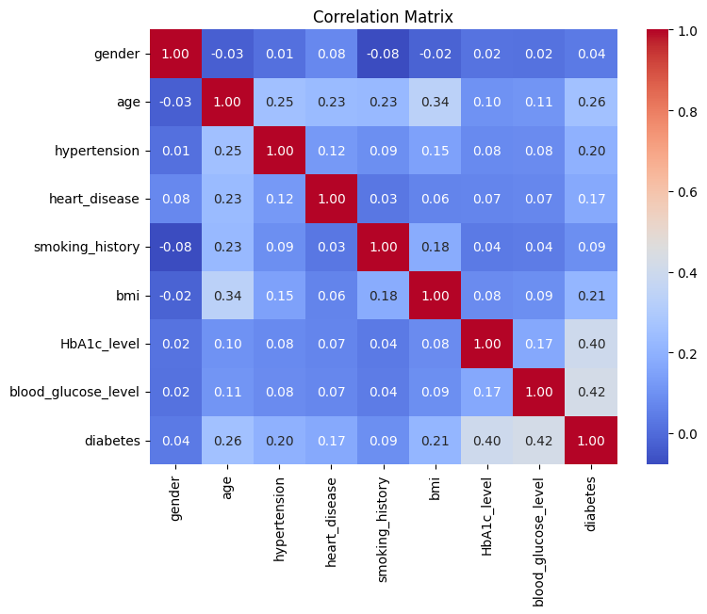

Slide 10
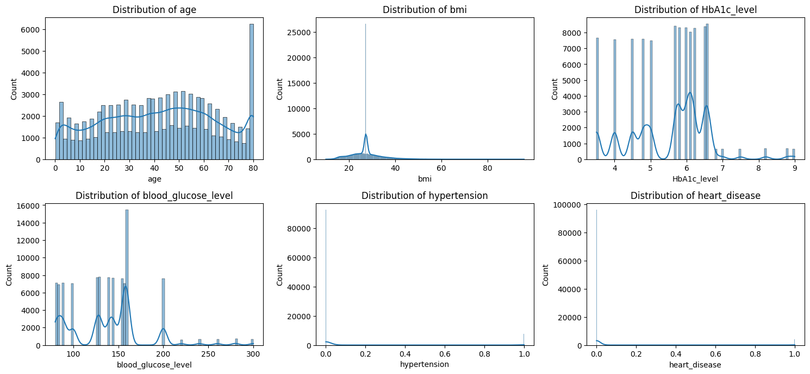
Numerical Distribution

Slide 11
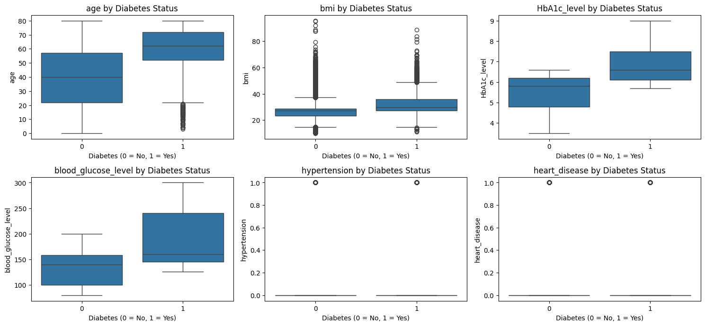
Numerical Boxplots

Slide 12
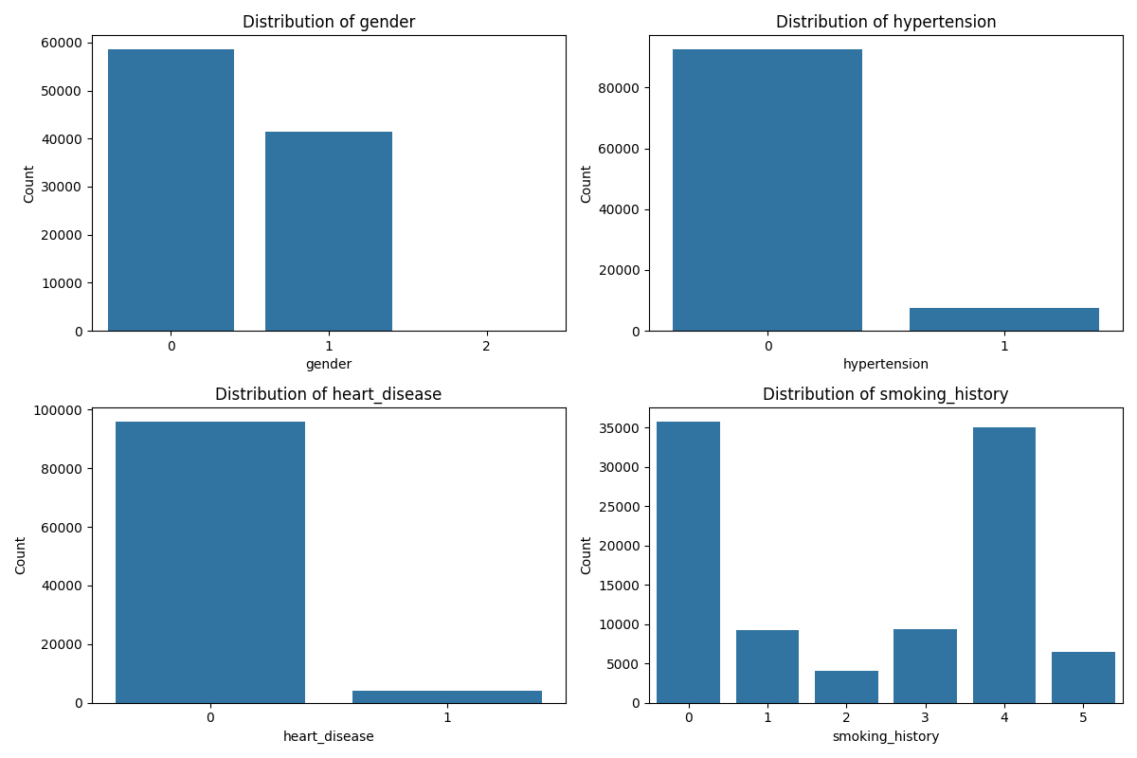
Categorical Distribution

Slide 13
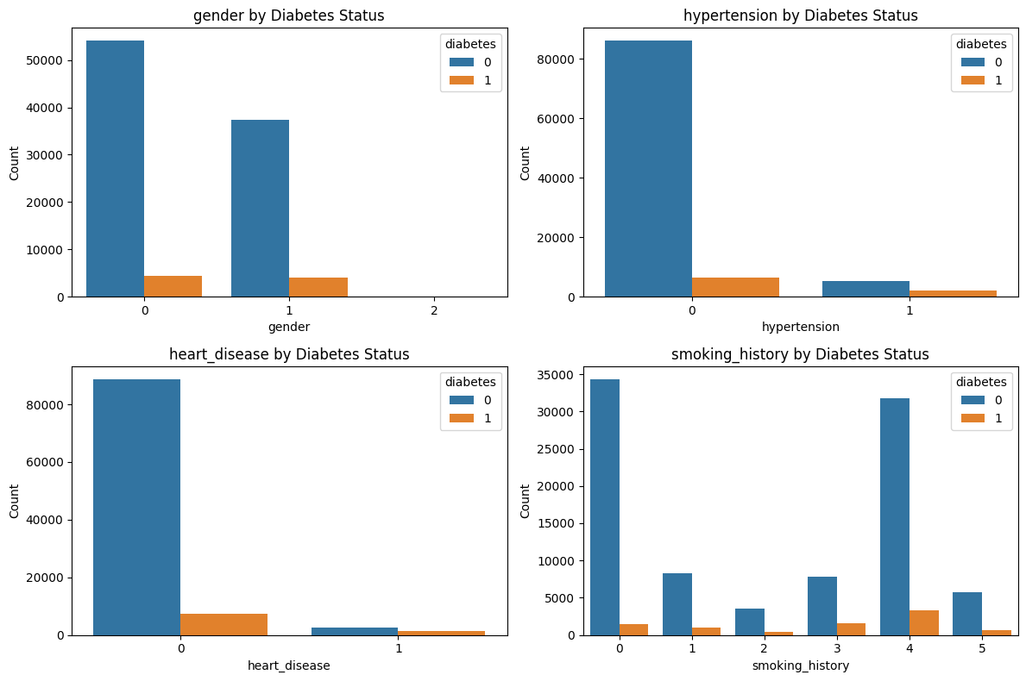
Categorical features by Diabetes

Slide 14
Key EDA Insights
Class Imbalance: The 91.5% vs. 8.5% split in diabetes status confirms the need for imbalance handling (e.g., SMOTE) to improve model performance on the minority class.
Feature Importance: HbA1c_level and blood_glucose_level show the strongest correlations with diabetes, followed by age, bmi, hypertension, and heart_disease. These features should be prioritized in modeling.
Categorical Features: hypertension, heart disease, and certain smoking history categories (e.g., Ever, Former) significantly increase diabetes risk, while gender shows a weaker effect.
Data Quality: The presence of 3,854 duplicates and 35.82% "No Info" in smoking_history highlights the need for deduplication and handling of missing/unknown data.
Age Consideration: Patients under 1 year are not relevant for diabetes prediction and may be excluded to improve model focus.

Slide 15
Data Pre‑processing
Categorical → Numeric • Label‑encoded gender & smoking_history for model compatibility.
Handle “No Info” in smoking_history • Recast as NaN → KNN imputation (k = 5, scaled features) → realistic mix (Never 56.6%, Ever 21.3%, etc.).
Remove Irrelevant Ages • Filtered out rows with age < 1 (911 infants, 0 diabetes cases).
Train‑Test Split (80/20) • Train 79 272 rows → SMOTE oversample to 144 936 (balanced 50/50). • Test 19 818 rows kept untouched to avoid leakage.
Feature Scaling • Standard‑scaled numeric columns (age, BMI, HbA1c, glucose) for algorithms like Logistic Reg & SVC.
Outcome • Clean, balanced dataset primed for modeling; note 3 854 duplicates slated for future removal.

Slide 16
Model Training
Models Used (No Tuning, Default Params) • Random Forest – Handles non-linear patterns, robust with SMOTE, gives feature importance • Logistic Regression – Simple, interpretable baseline for comparison • SVC (SVM) – Good for high-dimensional, non-linear patterns; benefits from scaling • XGBoost – High-performance gradient boosting, handles complex interactions
Training Setup • Train set: 144,936 (SMOTE-balanced, 50/50 diabetes) • Test set: 19,818 (unaltered) • Features: 8 total, scaled numeric inputs for model compatibility
Evaluation Metrics • Accuracy – Overall correctness • Precision – Avoid false positives • Recall – Catch all true positives (critical in healthcare) • F1-Score – Balance of precision & recall • ROC-AUC – Class separation ability, robust to imbalance

Slide 17
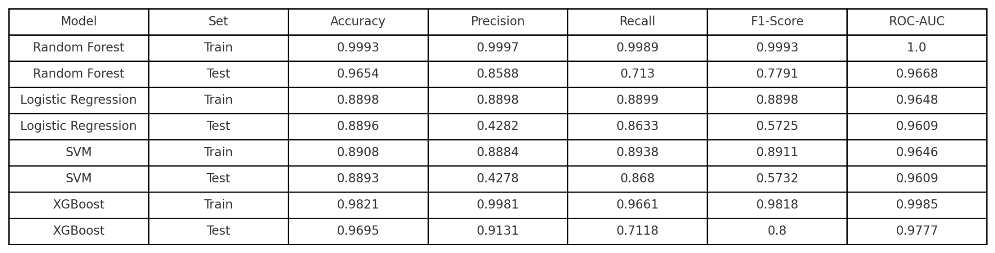
Model Comparison
The performance of the four models was evaluated on both the training and testing sets using the metrics defined above. The results are summarized in the table below.

Slide 18
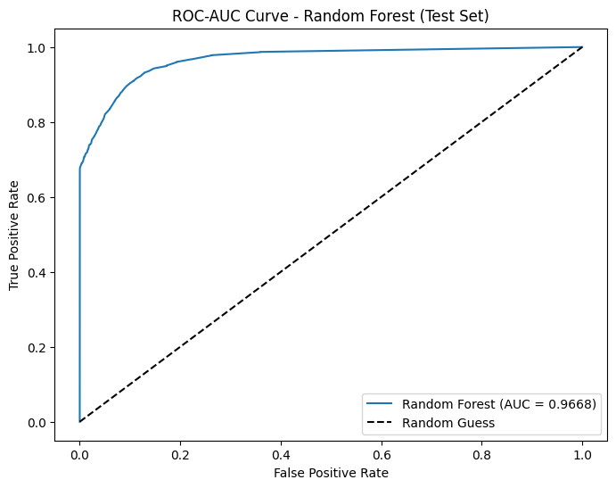
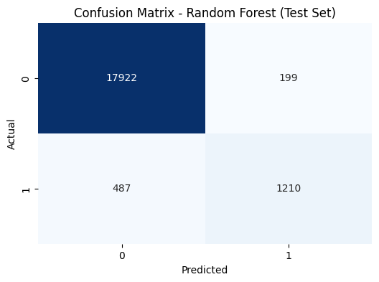

Slide 19
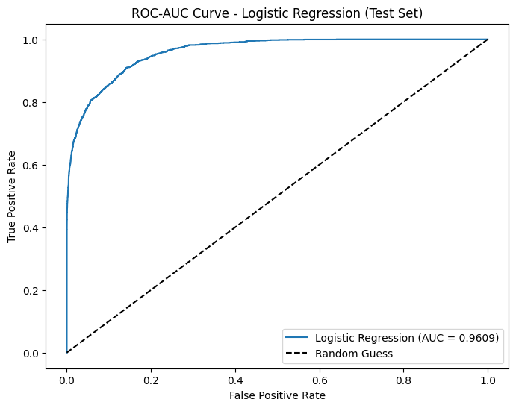
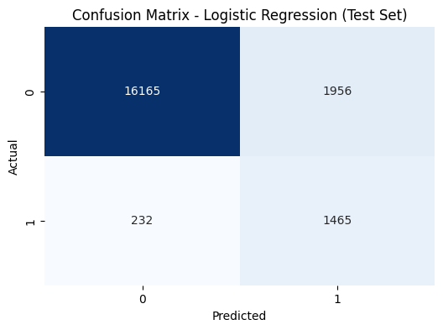

Slide 20
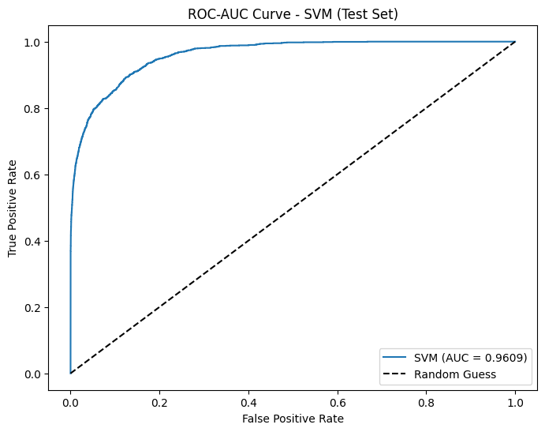
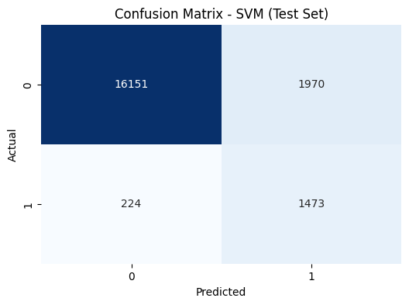

Slide 21
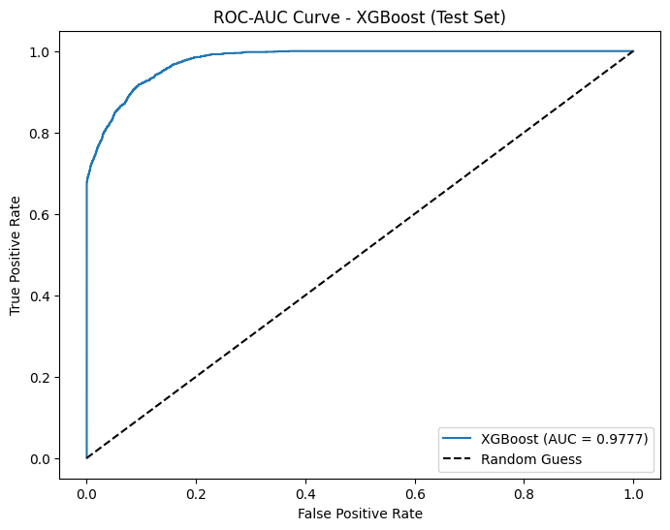
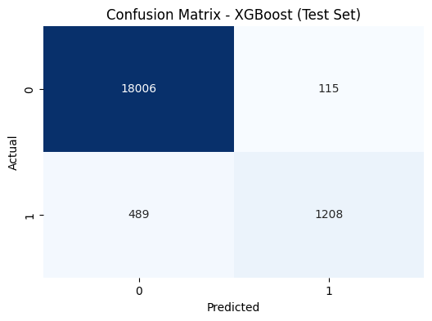

Slide 22
Observations
Training Performance:
Random Forest: Near-perfect scores across all metrics (Accuracy: 0.9993, ROC-AUC: 1.0000), indicating potential overfitting.
XGBoost: High performance (Accuracy: 0.9821, F1-Score: 0.9818), but slightly lower than Random Forest, suggesting less overfitting.
Logistic Regression and SVM: Similar performance (Accuracy ~0.89, ROC-AUC ~0.964), but significantly lower than tree-based models, likely due to their inability to capture nonlinear patterns effectively.
Testing Performance:
XGBoost: Best overall test performance (Accuracy: 0.9695, F1-Score: 0.8000, ROC-AUC: 0.9777), with the highest precision (0.9131), indicating fewer false positives.
Random Forest: High test accuracy (0.9654) but lower recall (0.7130) and F1-Score (0.7791) compared to XGBoost, suggesting it misses more diabetes cases.
Logistic Regression and SVM: Similar test accuracy (~0.889), but very low precision (~0.428) despite high recall (~0.86), leading to poor F1-Scores (~0.573). This indicates many false positives, making them less reliable for medical applications.
Overfitting:
Random Forest and XGBoost show significant drops in performance from training to testing (e.g., Random Forest F1-Score: 0.9993 to 0.7791), indicating overfitting, though XGBoost is less affected.
Logistic Regression and SVM show minimal overfitting, with stable performance between training and testing, but their overall performance is suboptimal.

Slide 23
Model Performance Analysis
XGBoost:
Strengths: Highest test accuracy (0.9695), precision (0.9131), and ROC-AUC (0.9777), making it the most reliable model for distinguishing between diabetic and non-diabetic patients. Its F1-Score (0.8000) balances precision and recall effectively.
Weaknesses: Recall (0.7118) is slightly lower than Logistic Regression and SVM, meaning it misses some diabetes cases. Some overfitting is evident (train F1-Score: 0.9818 vs. test: 0.8000).
Suitability: Best overall model for this task, especially in medical contexts where high precision (fewer false positives) is crucial to avoid unnecessary interventions.
Random Forest:
Strengths: High test accuracy (0.9654) and ROC-AUC (0.9668), indicating good overall performance. Precision (0.8588) is strong, though lower than XGBoost.
Weaknesses: Lower recall (0.7130) and F1-Score (0.7791) compared to XGBoost, meaning it misses more diabetes cases. Significant overfitting (train Accuracy: 0.9993 vs. test: 0.9654).
Suitability: A strong contender but less effective than XGBoost due to lower recall and more pronounced overfitting.
Logistic Regression and SVM:
Strengths: High recall (~0.86–0.87), ensuring most diabetes cases are identified. Minimal overfitting (stable performance between train and test).
Weaknesses: Very low precision (~0.428), leading to many false positives and poor F1-Scores (~0.573). This makes them unreliable for clinical use, as false positives can lead to unnecessary treatments.
Suitability: Not suitable for this task due to poor precision and overall performance, despite high recall.

Slide 24
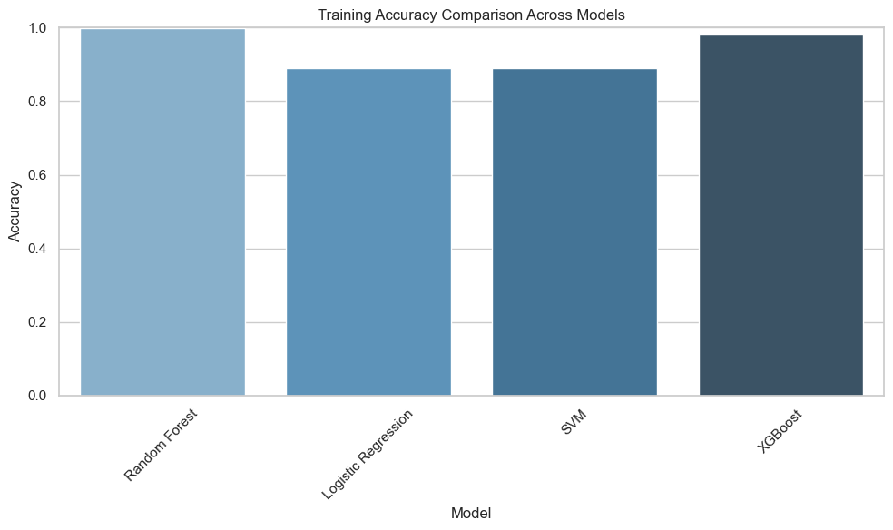

Slide 25
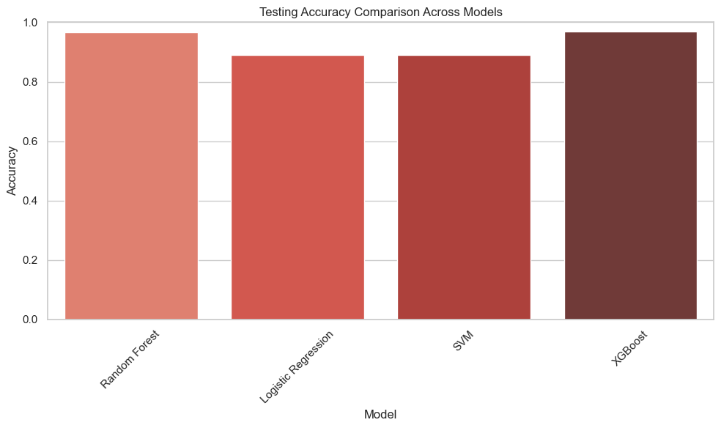

Slide 26
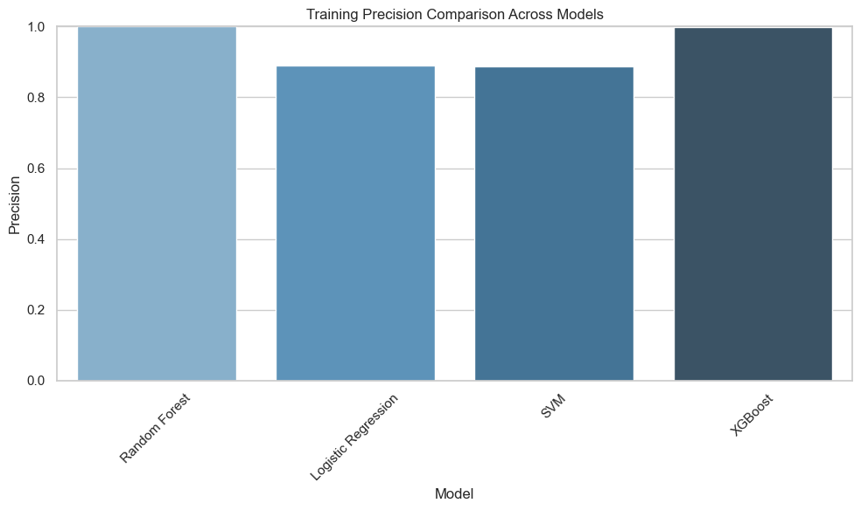

Slide 27
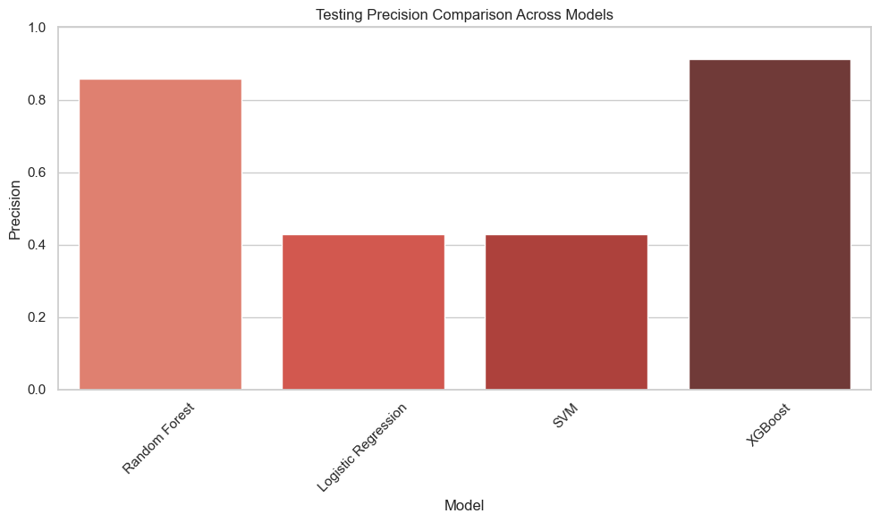

Slide 28
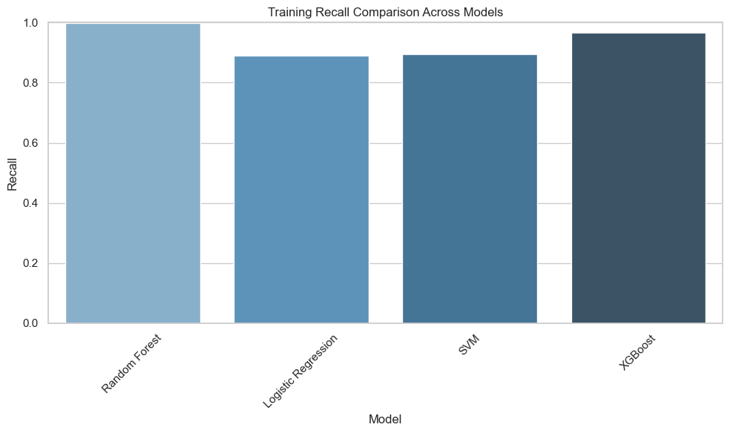

Slide 29
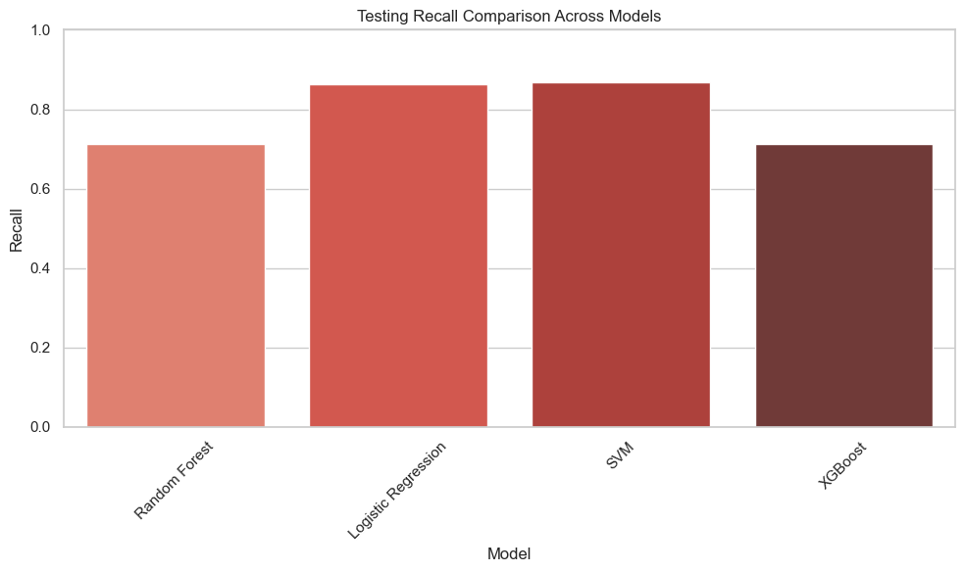

Slide 30


Slide 31
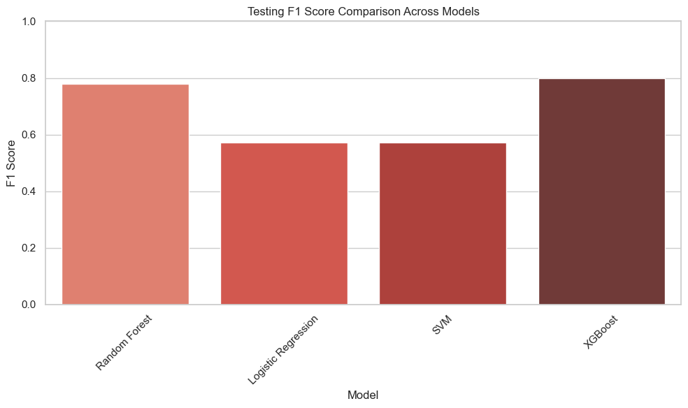

Slide 32
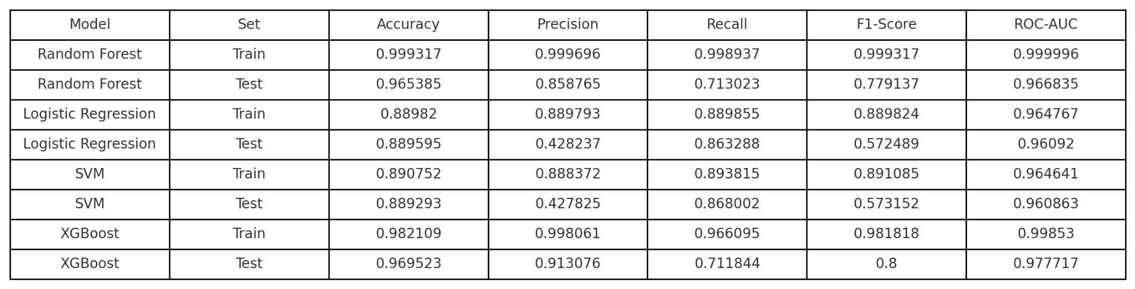
Conclusion
XGBoost is the best-performing model for diabetes prediction in this study, with a test accuracy of 0.9695, precision of 0.9131, and ROC-AUC of 0.9777. It effectively identifies at-risk patients, supporting early intervention and personalized treatment planning in healthcare settings. However, addressing overfitting, duplicates, and interpretability is crucial before deployment. The model also enables researchers to explore the impact of medical and demographic factors on diabetes, with HbA1c_level and blood_glucose_level confirmed as key predictors.

